Slide 1
Predicting Heart Disease
Brandon Parmanand
STA5736

Slide 2
Problem
Heart disease is one of the leading causes of death in the world. There are risk factors that can lead to the development of heart disease.
People who have heart disease or at risk of heart disease need early detection to mitigate this and, in this project, we will look at some of the factors that are associated with it and see if we can develop a good model to predict it..
The dataset was obtained from Data obtained from https://www.kaggle.com/datasets/fedesoriano/heart-failure-prediction which was released in 2021.
Notes:
Heart disease is one of the leading causes of death in the world. There are risk factors that can lead to the development of heart disease.
People who have heart disease or at risk of heart disease need early detection to reduce the risk of heart attacks and death.
Can we generate a model sufficient enough to predict whether someone has heart disease.

Slide 3
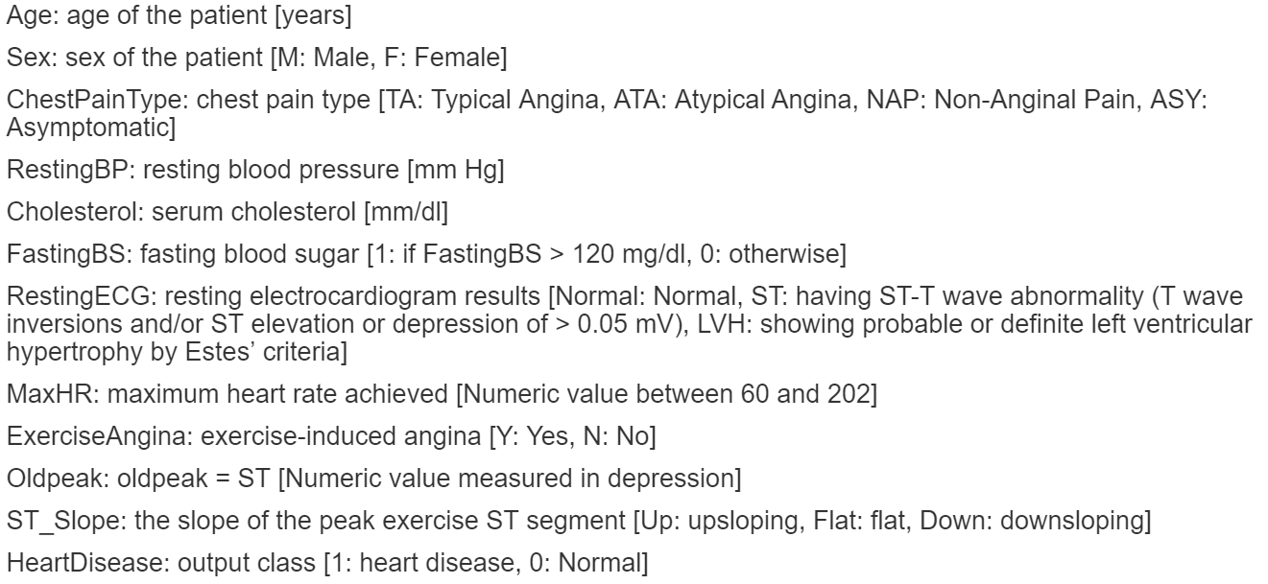
Variables
Notes:
12 variables with Heart Disease being the dependent variable. 1 indicates you have heart disease and 0 is normal most of these are self explanatory. Chest pain type Typical (classic) angina chest pain consists of (1) Substernal chest pain or discomfort that is (2) Provoked by exertion or emotional stress and (3) relieved by rest or nitroglycerine (or both).
Atypical (probable) angina chest pain applies when 2 out of 3 criteria of classic angina are present. Old peak is the depressions in your exercise . ST is linked to heart conditions

Slide 4
Models
Logistic Regression
Decision Tree
XGBoost Method

Slide 5
I ran the data with strings as factors
Cholesterol and Resting Heart Rate included values of 0 which is not possible for a living person. I turned these into NA and removed the NAs from the data.
I broke the data out into training and testing dataset using 80% for training and the remaining 20% for testing/validation.
Notes:
I ran the data with strings as factors
Cholesterol and Resting Heart Rate included values of 0 which is not possible for a living person. I turned these into NA and removed the NAs from the data.
I broke the data out into training and testing dataset using 80% for training and the remaining 20% for testing/validation.
no disease:390 disease:356

Slide 6
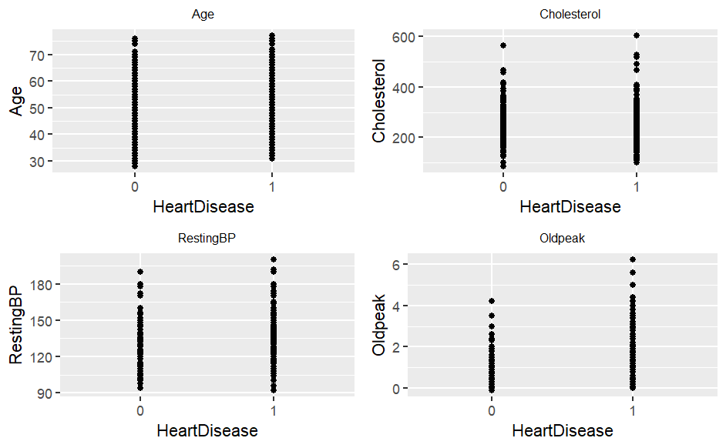
Notes:
As expected, we see people with Heart disease are slightly older than people without heart disease. The same goes for cholesterol, resting BP and Oldpeak (which is ST depressions induced by exercise on the ECG) with more on the higher end of the scale.

Slide 7
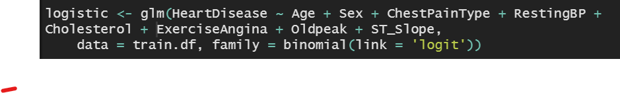
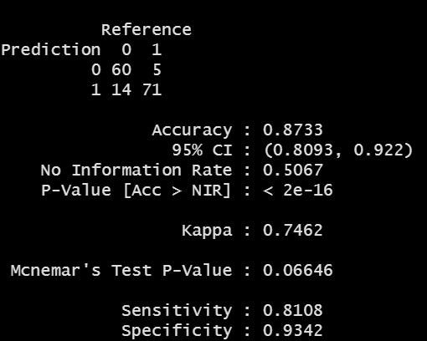
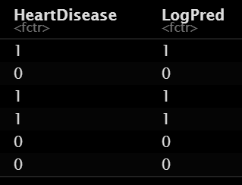
Logistic
Notes:
I first ran the logistic model with all variables with an AIC score of 415. I used the setpAIC Backward model to estimate a reduced model which removed the Max Heart rate, Resting ECG, and Fasting Blood sugar variables. THe AIC difference was marginal with an AIC of 412 for the simplified model. In this case I chose to move ahead with the simplified model to predict heart disease.
Accuracy was .8733 But I worry that I should have left these variables in as the

Slide 8
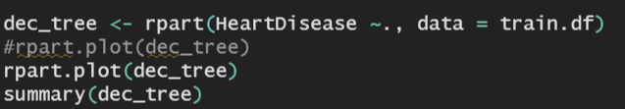
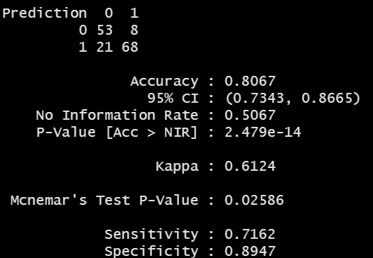
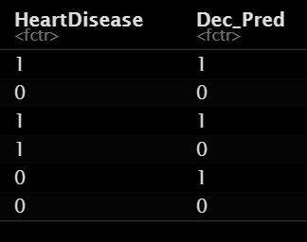
Decision Tree
Notes:
Accuracy .8067 lower than the logistic model.

Slide 9
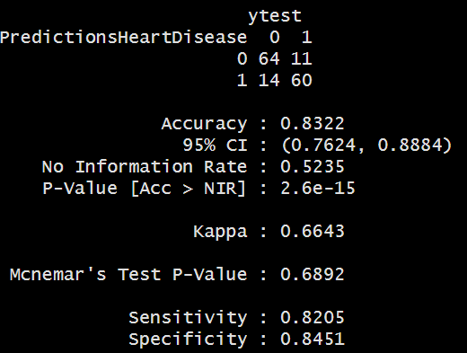
XGboost
Notes:
Accuracy .8322

Slide 10
Results

Slide 11
Conclusion
In order to predict heart disease in patients, the logistic model has the highest accuracy and would be best to use this to predict heart disease.
Notes:
In order to predict heart disease in patients, the logistic model has the highest accuracy and would be best to use this to predict heart disease. Even though the other models performed well.
Most important variabbles is Importatn variables were chest pain type and exercise angina and the sex male is bad.
Surpirse that Max Heart rate, Resting ECG, and Fasting Blood sugar variables.
Different? I would include all variables to look at specifity, maybe other models

